Slide 1

PRESENTATION OF OUR WEBSITE
Title:The electricity service website
As a Field work for Course
INTERNET PROGRAMMING LABORATORY (CSE 326)
By
Sr. No. | Registration No | Name of Students | Roll No | Total Marks | Marks Obtained | Signature
1 | 12217513 | Kondagurla Karthik | 13
2 | 12216358 | Ayush Aryan | 37
3 | 12224169 | Ankit Kumar Rai | 62
Submitted To Mrs. Aashima ma’am
Lovely Professional University Jalandhar, Punjab, India.

Slide 2
Table Of Content
Acknowledgment
Introduction
Goal
Description

Slide 3
ACKNOWLEDGEMENT
I would like to express my special thank of gratitude to Mrs. Aashima Ma’am for their able Guidance and support in completing my project.
I would also like to thank my team members for their contribution and dedication in this project.

Slide 4
INTRODUCTION
We made a electricity board Website. It helped to bring all services and facilities on one digital platform.
We provide the facilities of pay electricity bills, tracking electricity consumption. we have also provide the facilities of getting new electricity connection. we have also gave the feedback based system to consumer that help us more improve in our website.

Slide 5
GOALS
The main aim of making this website is bring all the offline service on one platform.
where consumer can easily use all facilities
It reduce physical work of consumer
beacuse they can pay bill from anywhere and anytime.We also provide contact facility to consumer where they easily solve thier query. It is fast process ,less time taken and less physical appearance at electricity office

Slide 6
DESCRIPTION
We have added office logo , Home , contact and quick links tab.
In Home tab we have provided facilities to user can check profile.
In Contact We provide customer support system where they solve their query.

Slide 7
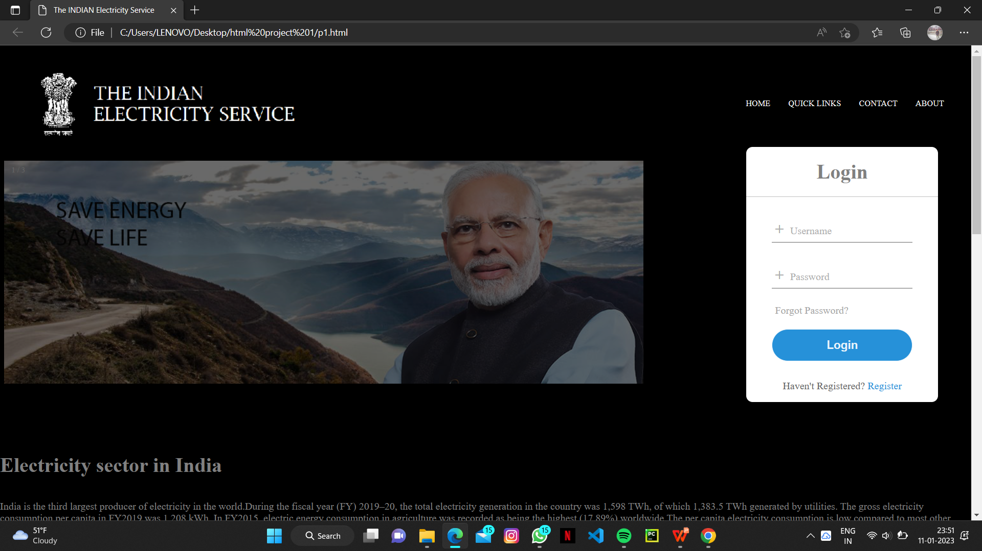
We have added Login window where consumer can easily access
Their account detail. Also, added pictures of some electricity quotes on them.

Slide 8
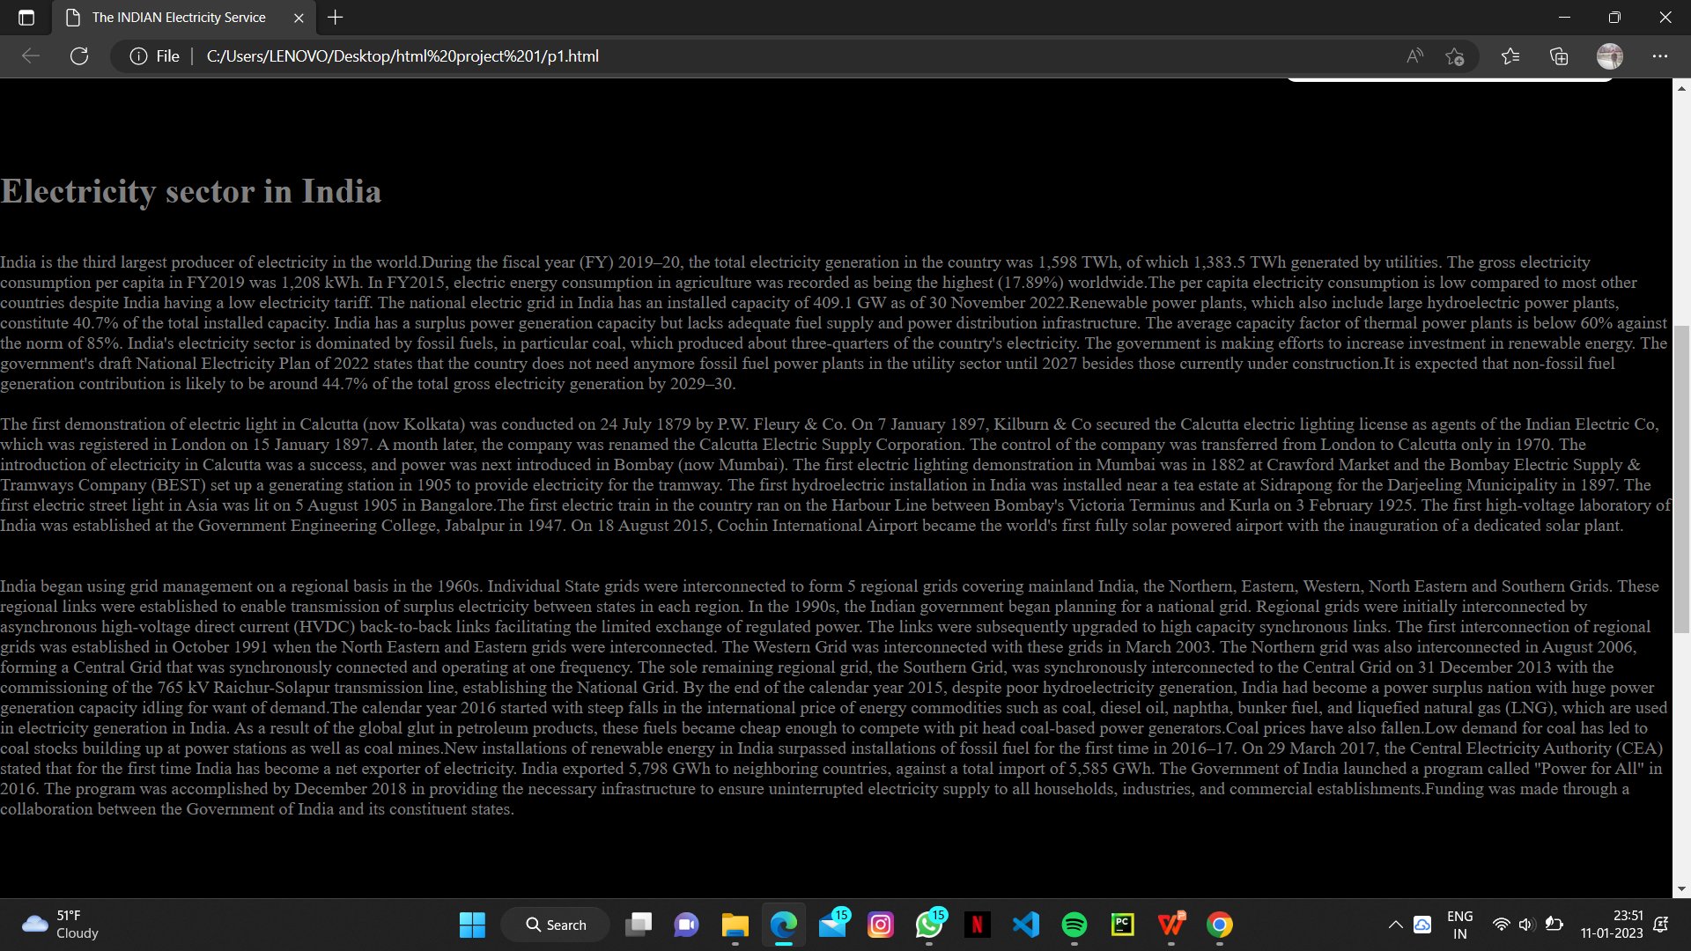
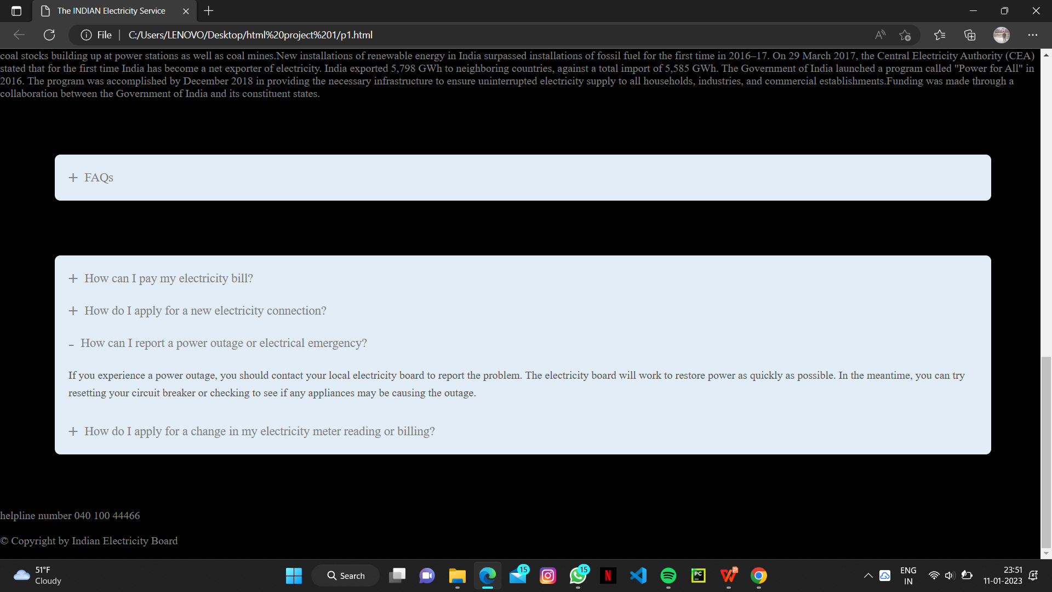
We have added the some paragraph on save electricity and some fact about our Electricity board.
The FAQs section where we provide some general question and answer that helps the consumer quickly .

